Slide 1

FinTra
A Behaviour-First Financial Operating System for Salaried India
Founder-led Indian startup redefining personal finance through behavioural accountability. Built in India, for India's 200M+ salaried population.

Slide 2
India's Salaried Population Manages Money Reactively
Over 200 million salaried individuals in India face a persistent challenge: spending decisions happen impulsively early in the month, before any financial structure is in place.
200M+
Salaried Indians lacking financial structure
Most finance apps intervene after money is spent, offering insights without prevention. This reactive approach fails to address the root cause.
Key Issue
The Result
Tracking expenses does not change behaviour
Chronic overspending patterns
Weak savings discipline
Recurring financial stress and anxiety
Month-end cash crunches

Slide 3
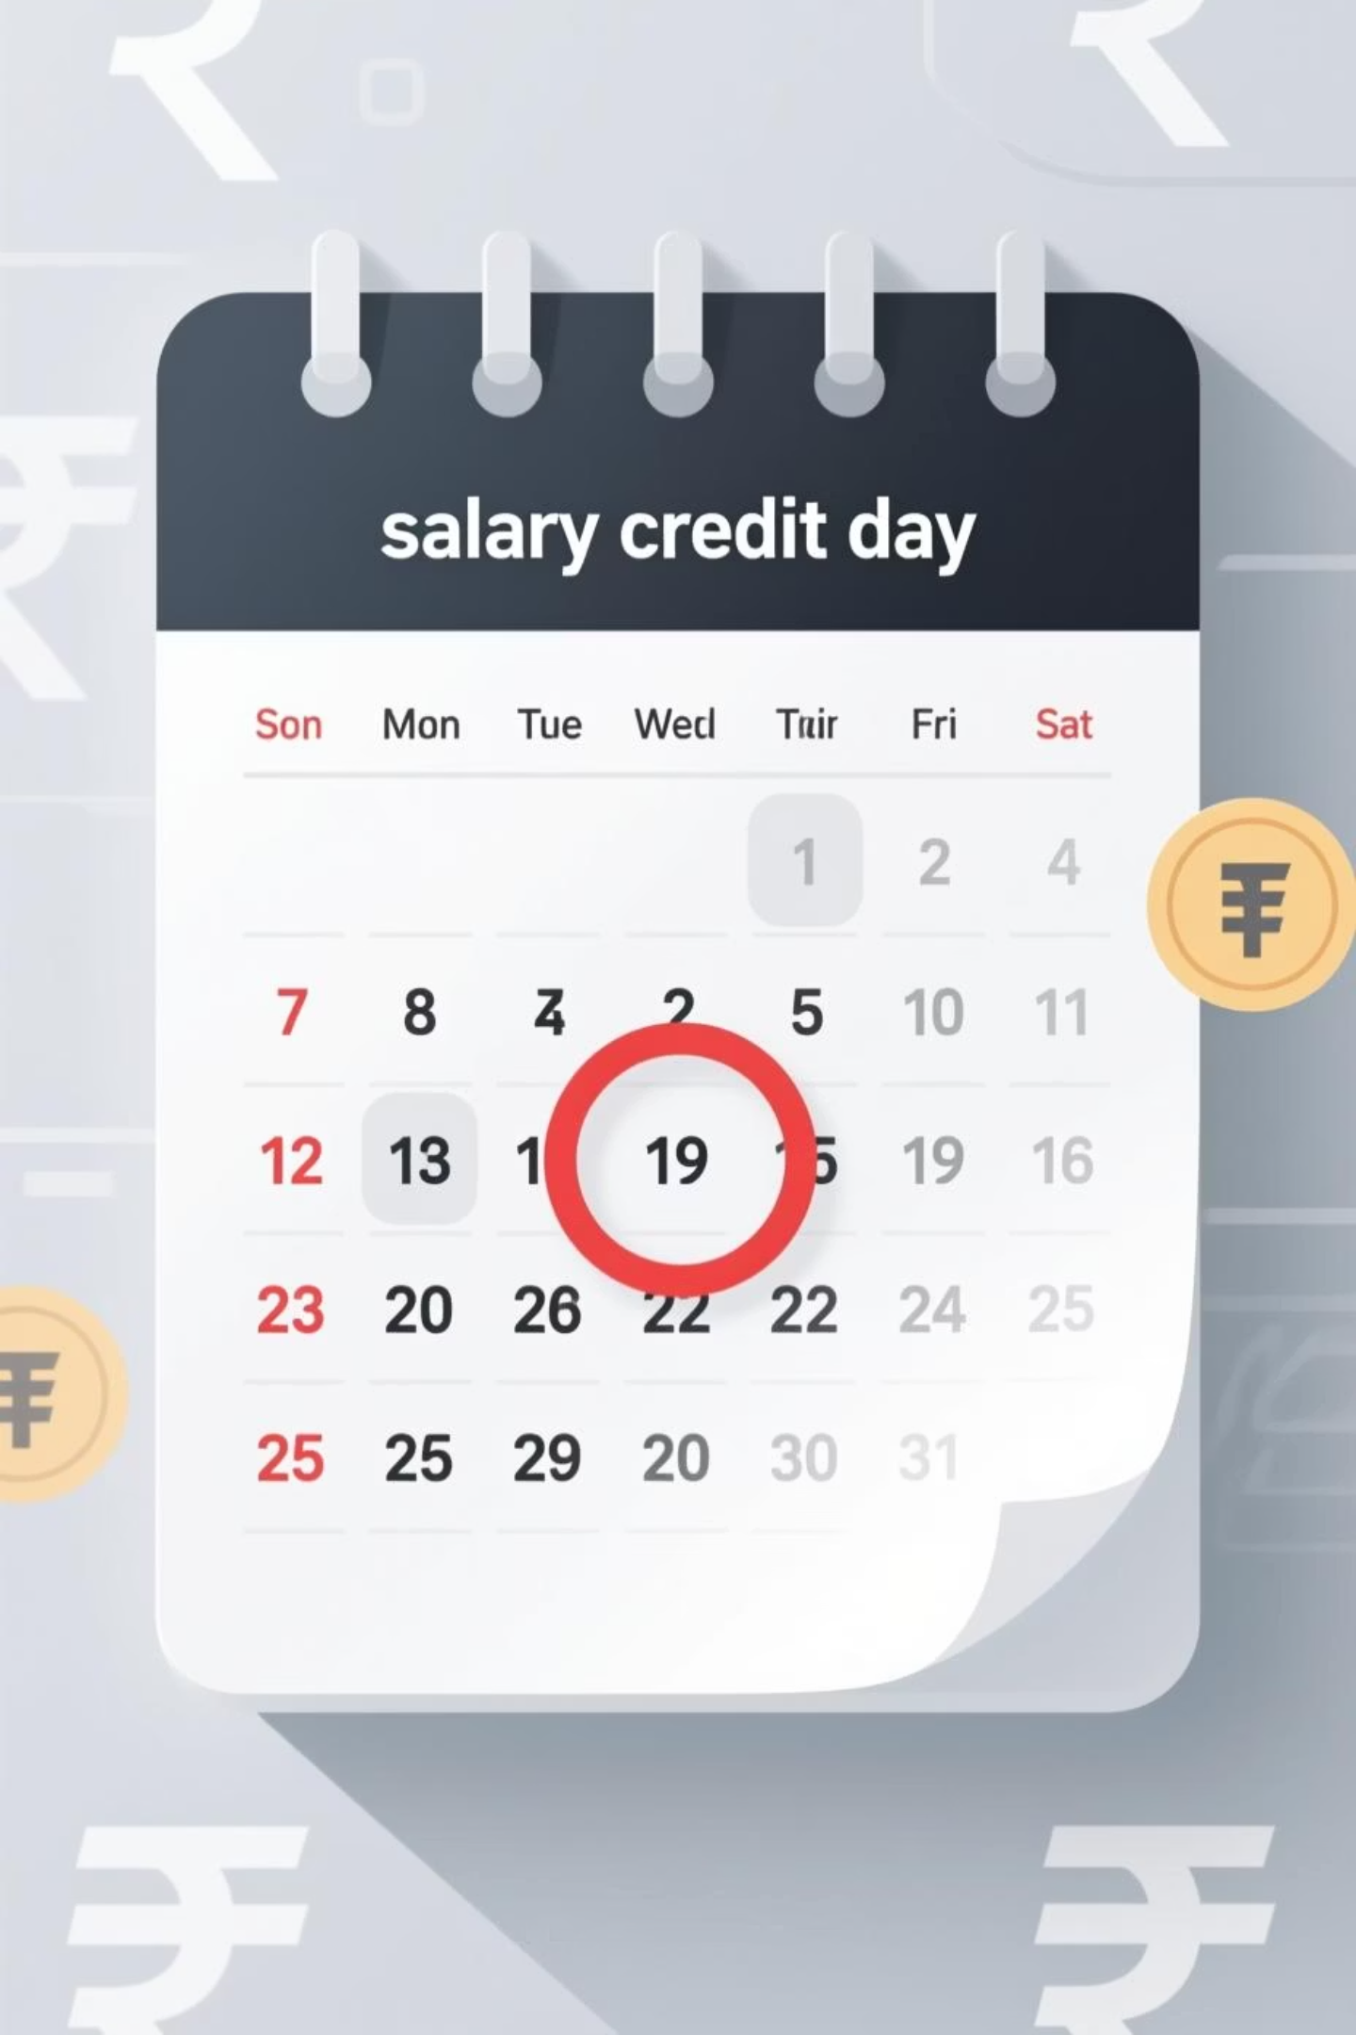
Money Decisions Are Behavioural, Not Informational
Users already know what they spend
The problem isn't awareness—it's the absence of real-time accountability during the moment of spending.
The most critical moment is salary credit day
This is when financial structure should be established, yet existing tools completely ignore this pivotal window.
Behavioural accountability beats financial literacy
FinTra is built around how people actually behave with money—not how spreadsheets and budgets assume they should.

Slide 4
FinTra Controls the Full Salary Cycle
FinTra isn't an expense tracker. It's a monthly financial control system that intervenes before damage occurs, establishing structure at the moment of salary credit and maintaining accountability throughout the spending cycle.
01
02
03
Salary Snapshot
Planned Allocations
Guided Spending
Capture total incoming salary at month start
Define spending buckets before any money moves
Real-time pacing nudges and intelligent warnings
04
05
Behaviour Monitoring
Month-End Closure
Continuous accountability checks throughout the month
Formal review and learning for next cycle

Slide 5
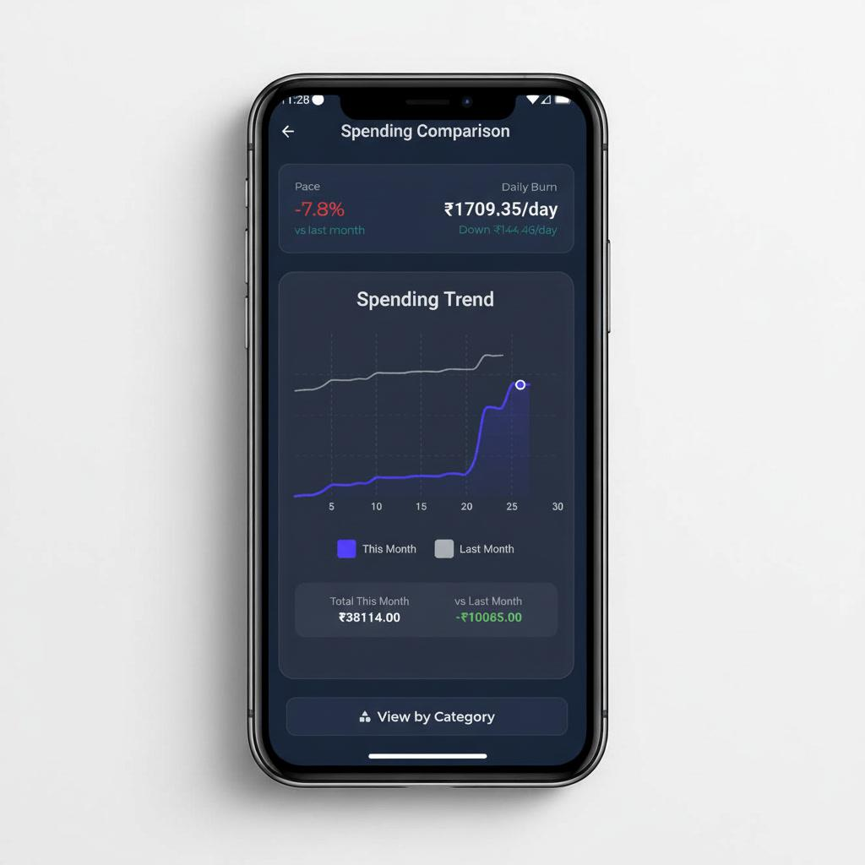
Product Status: Live and Evolving
This is not a concept or prototype. FinTra is a live MVP with real users actively managing their finances on the platform.
Manual expense tracking system
Real-time total spent calculations
Remaining balance visibility
Category-wise breakdown views
Savings progress monitoring
Behavioural nudges (rule-based engine)
Weekly product iteration cycles
MVP Status | Core Features
Live | 7
Active users managing finances daily | Built and functioning

Slide 6





Target Market: India-First Strategy
Total salaried population in India
Focus:Ages between 21 to 33
~200M+
~80M (40%)
Within Income Range: ₹30k – ₹1.23L per month
Geography
~ 36M(45%)
Urban and semi-urban centers
Core Customer Profile
Young salaried professionals with high discretionary spending patterns but low structural discipline. This demographic benefits most from behavioural financial control systems.
Initial Focus: India market dominance
Long-Term Vision: Expansion to global salaried markets

Slide 7
Roadmap: Foundation Phase
Next 6 Months — Building for Scale
Platform Stability
1
Stabilize MVP across Android and iOS devices with consistent performance
2
Intelligence Engine
Strengthen expense categorization and insight generation capabilities
User Experience
3
Improve onboarding flow and retention mechanisms based on user feedback
4
Data Infrastructure
Build robust analytics and monitoring systems for product decisions
Controlled Growth
5
Prepare technical and operational foundation for scaling
This phase prioritizes reliability over rapid expansion. The focus is achieving genuine product-market fit with deep user engagement, not vanity metrics.
Milestone
Product-market fit with first 1,000 deeply engaged users

Slide 8

Funding Ask: ₹25 Lakhs
DPIIT Grant / Seed Support for Foundation Phase
Engineering Support
Contract developers for key feature builds
Infrastructure
Cloud services, APIs, and development tooling
Device Testing
Multi-device compatibility and performance testing
Security & Reliability
Financial data protection and system uptime
Founder Runway
This funding request is tied directly to product quality and execution velocity—not lifestyle or overhead. Every rupee accelerates our path to serving India's salaried population effectively.
Full-time execution sustainability for 6+ months

Slide 9





Why Support FinTra
India-First Problem
Behaviour-Driven
Product Built
Built specifically for Indian salaried behaviour patterns
Solution addresses root cause, not symptoms
Live MVP with active users, not just an idea
Founder Committed
High Impact Model
Full-time dedication to execution and impact
Maximum social value, minimal waste
FinTra is building discipline—not dependency.
With DPIIT support, FinTra can scale responsible financial behaviour across India, creating lasting impact for millions of salaried households.

